Slide 1
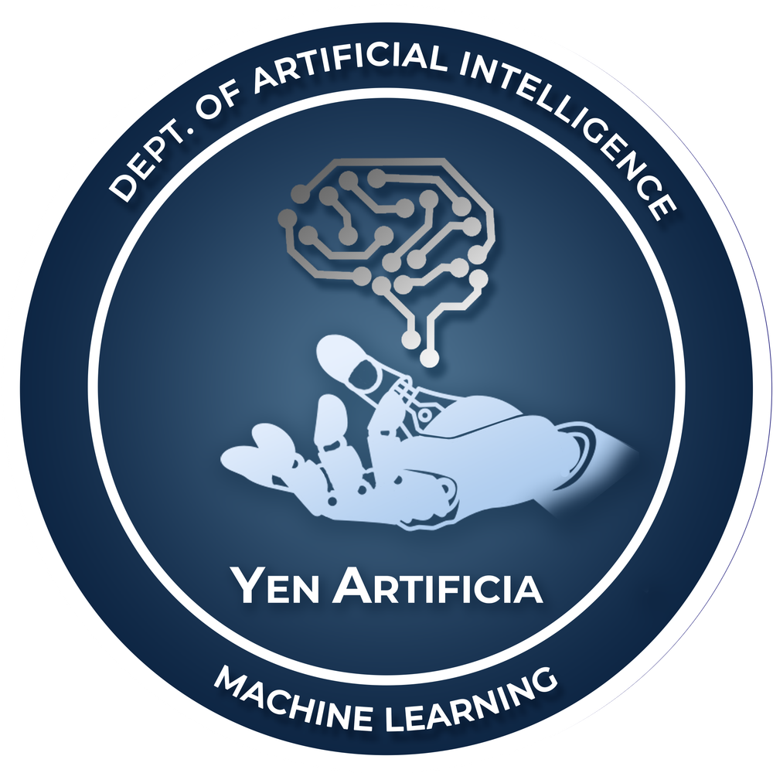

YENEPOYA INSTITUTE OF TECHNOLOGY
N. H. 13, Thodar, Moodbidri, Mangaluru - 574 225, Karnataka.
Recognized by AICTE, New Delhi, Approved by Govt. of Karnataka, Affiliated to VTU, Belagavi
DEPARTMENT OF ARTIFICIAL INTELLIGENCE AND MACHINE LEARNING
Idea Title
Team Name
Team Leader Name
Member 2
Member 3
Member 4
www.yenartificia.com

Slide 2
YENEPOYA INSTITUTE OF TECHNOLOGY
N. H. 13, Thodar, Moodbidri, Mangaluru - 574 225, Karnataka.
Recognized by AICTE, New Delhi, Approved by Govt. of Karnataka, Affiliated to VTU, Belagavi
DEPARTMENT OF ARTIFICIAL INTELLIGENCE AND MACHINE LEARNING
Idea Title
Proposed Solution (Describe your Idea/Solution/Prototype)
  Detailed explanation of the proposed solution
  How it addresses the problem
  Innovation and uniqueness of the solution
www.yenartificia.com

Slide 3
YENEPOYA INSTITUTE OF TECHNOLOGY
N. H. 13, Thodar, Moodbidri, Mangaluru - 574 225, Karnataka.
Recognized by AICTE, New Delhi, Approved by Govt. of Karnataka, Affiliated to VTU, Belagavi
DEPARTMENT OF ARTIFICIAL INTELLIGENCE AND MACHINE LEARNING
TECHNICAL APPROACH
Technologies to be used (e.g. programming languages, frameworks, hardware)
Methodology and process for implementation (Flow Charts / Images / working prototype)
www.yenartificia.com
www.yenartificia.com

Slide 4
YENEPOYA INSTITUTE OF TECHNOLOGY
N. H. 13, Thodar, Moodbidri, Mangaluru - 574 225, Karnataka.
Recognized by AICTE, New Delhi, Approved by Govt. of Karnataka, Affiliated to VTU, Belagavi
DEPARTMENT OF ARTIFICIAL INTELLIGENCE AND MACHINE LEARNING
FEASIBILITY AND VIABILITY
Analysis of the feasibility of the idea
Potential challenges and risks
Strategies for overcoming these challenges
www.yenartificia.com

Slide 5
YENEPOYA INSTITUTE OF TECHNOLOGY
N. H. 13, Thodar, Moodbidri, Mangaluru - 574 225, Karnataka.
Recognized by AICTE, New Delhi, Approved by Govt. of Karnataka, Affiliated to VTU, Belagavi
DEPARTMENT OF ARTIFICIAL INTELLIGENCE AND MACHINE LEARNING
IMPACT AND BENEFITS
Potential impact on the target audience
Benefits of the solution (social, economic, environmental, etc.)
www.yenartificia.com

